Slide 1
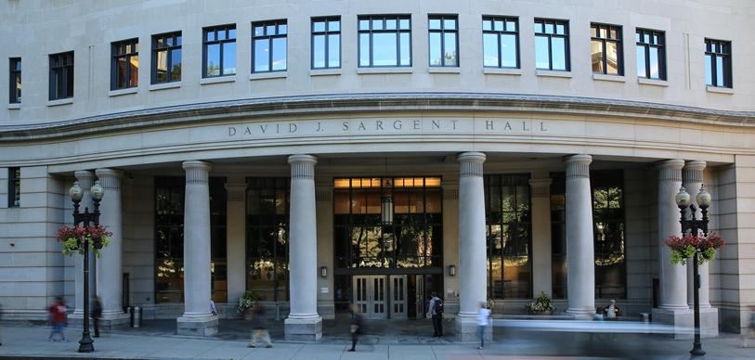

Navigating the World of Public Benefits
Michael R. DiFilippo & Alessandra Ambrogio

Slide 2

Problem: Myriad of Public Benefits

Slide 3

Context: Clinical Programs
Health Law Clinic
Suffolk Prosecutors Program
Indigenous Peoples Rights Clinic
Family Advocacy Clinic
Supreme Court Clinic
Innocence Clinic
Intellectual Property & Entrepreneurship Clinic
Suffolk Defenders Program
Juvenile Defenders Clinic
Accelerator Practice
Immigration Clinic
Housing Discrimination Testing Program

Slide 4
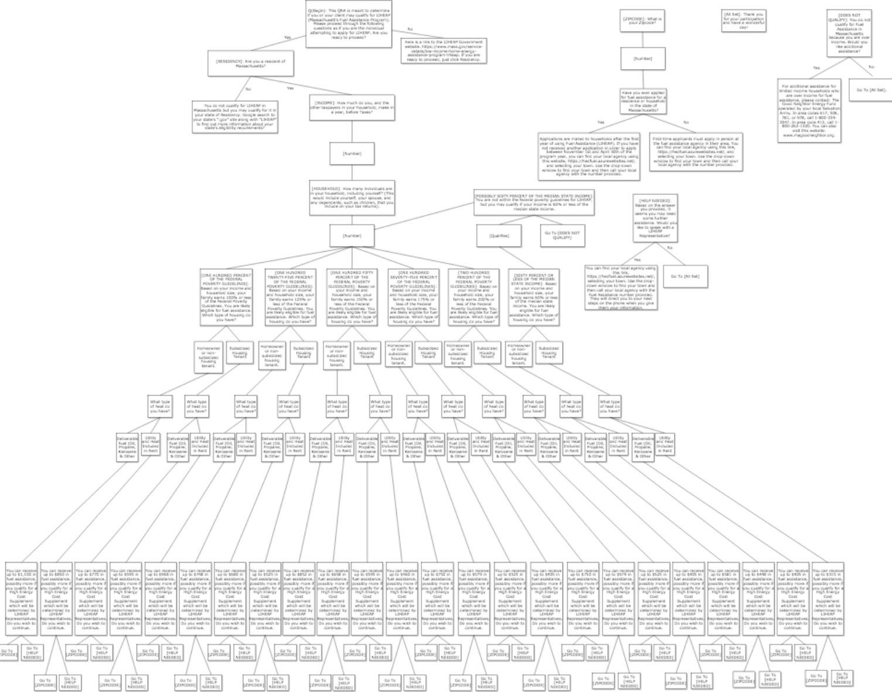
Solution: Flowchart/Decision Tree

Slide 5
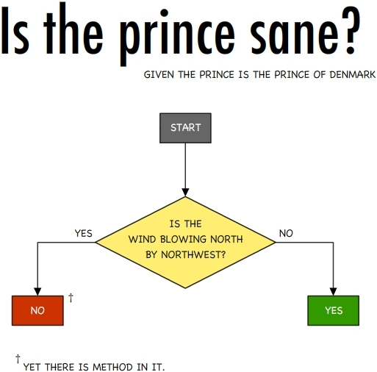

Slide 6
Q: Is the wind blowing north by northwest? A: Yes. Q: No. Yet there is method in it. A: No. Q: Yes.

Slide 8
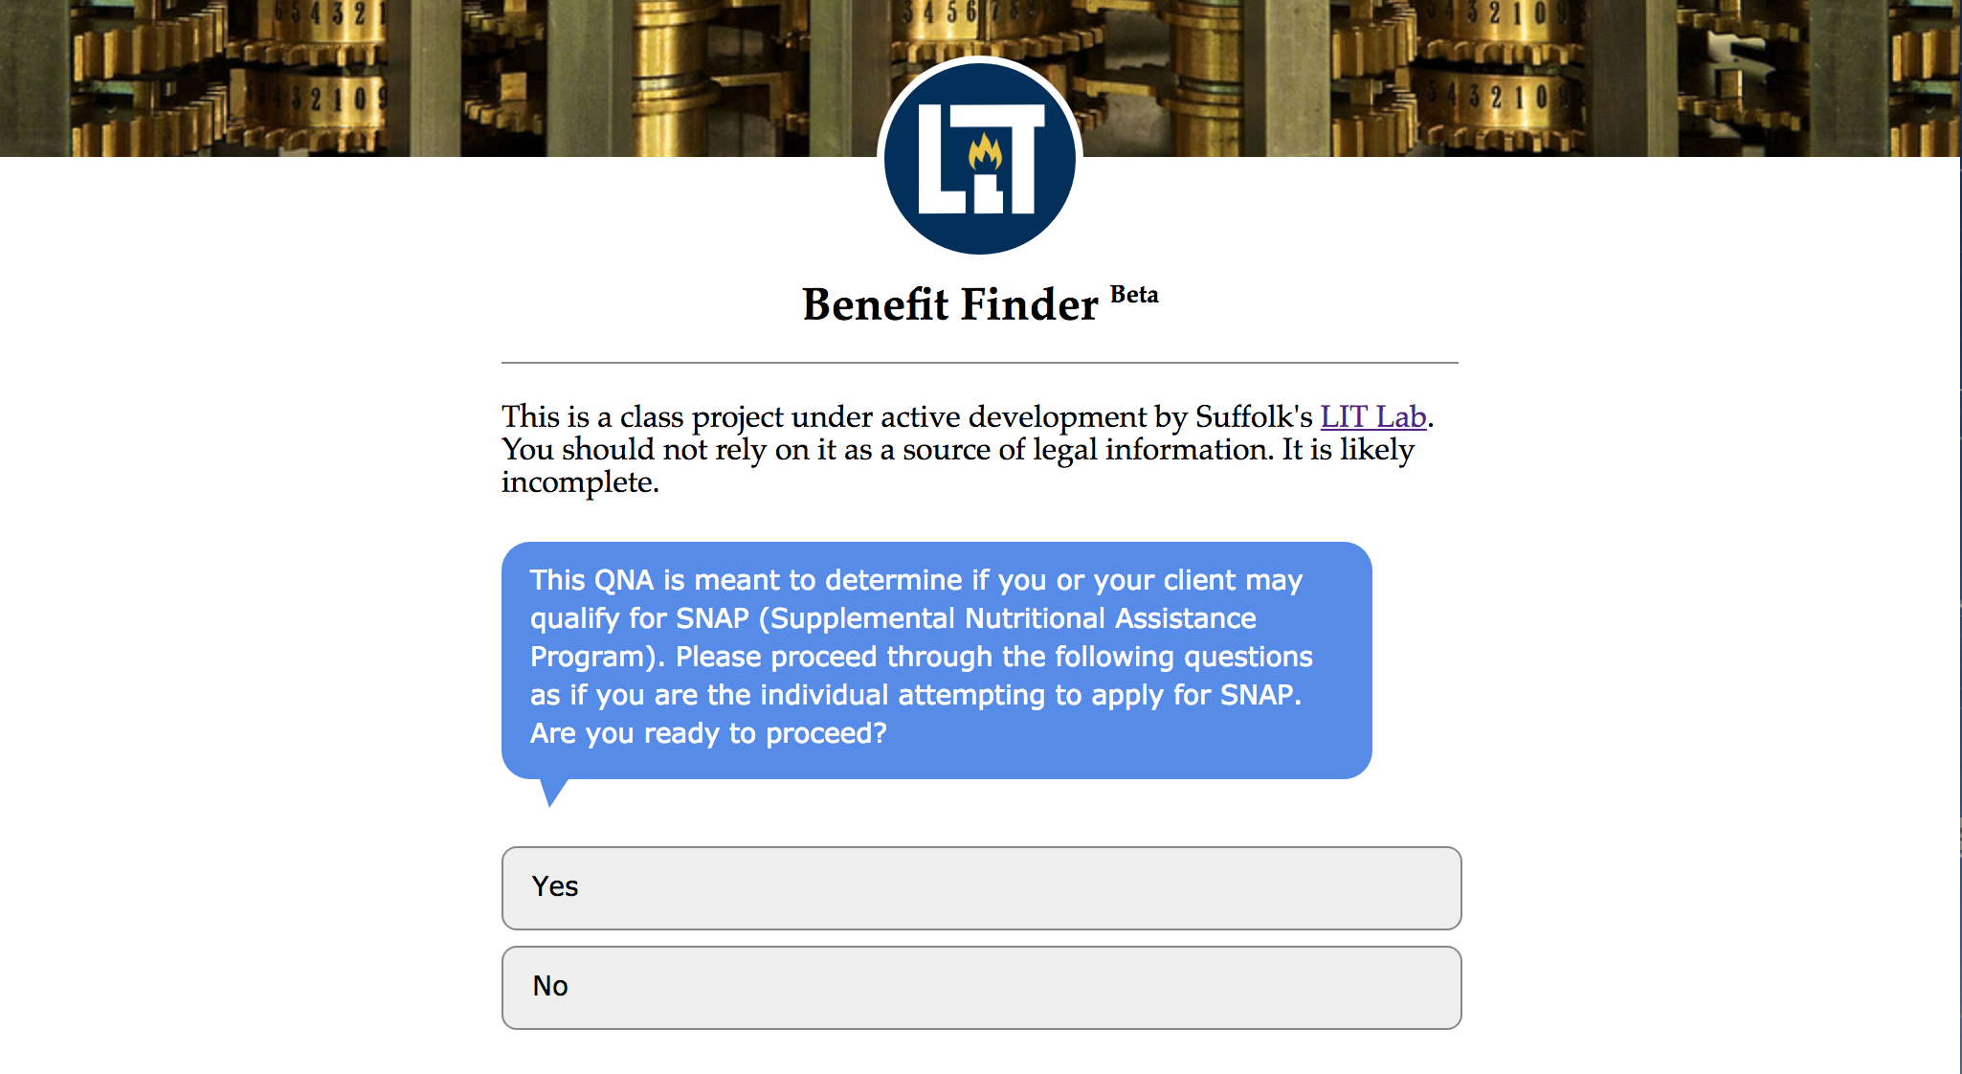

Slide 9
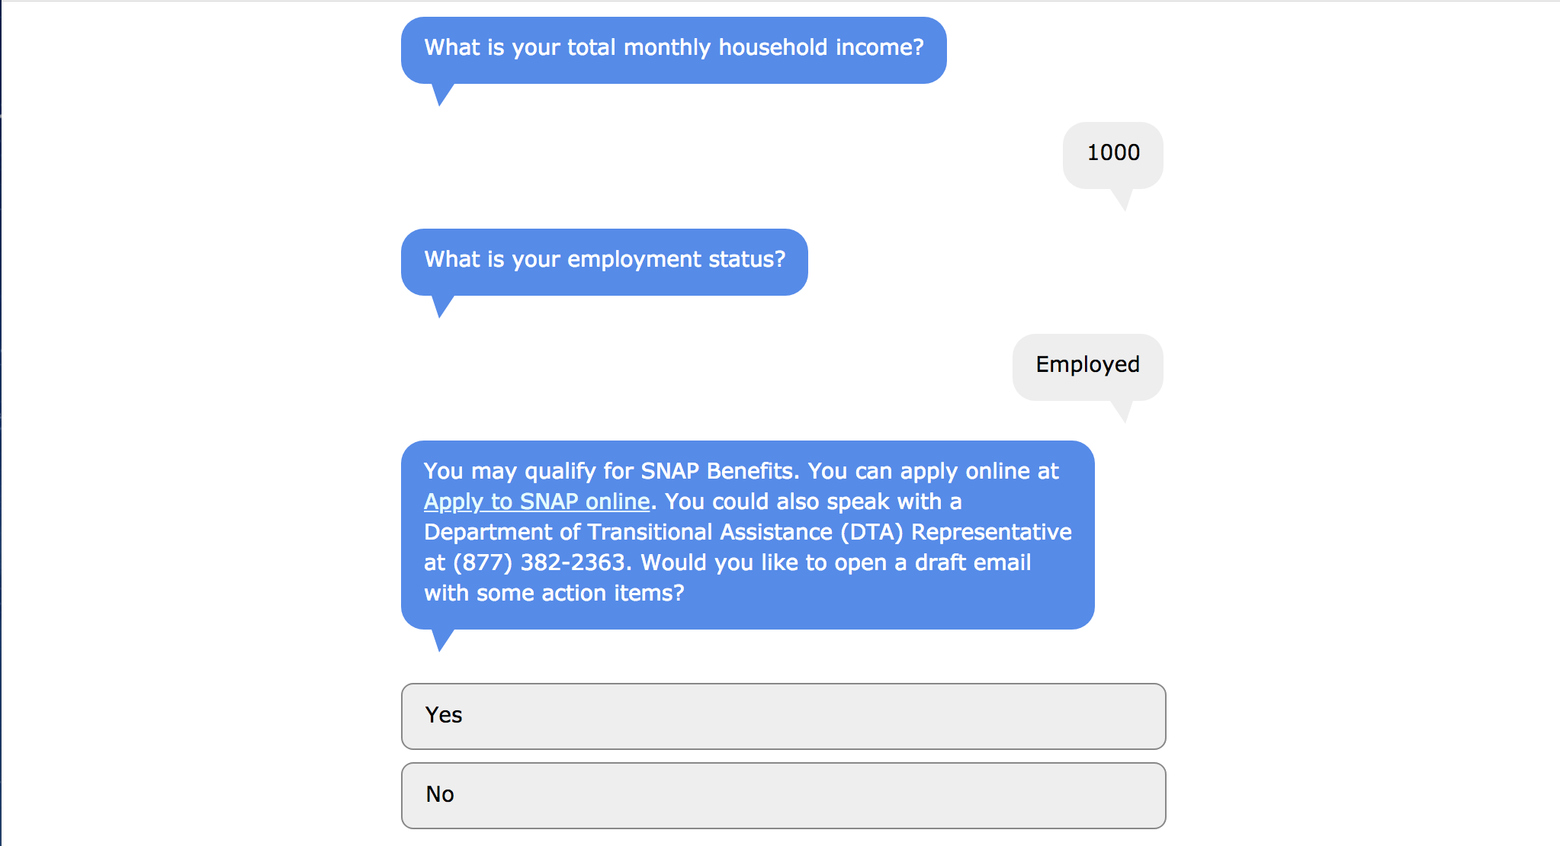

Slide 10
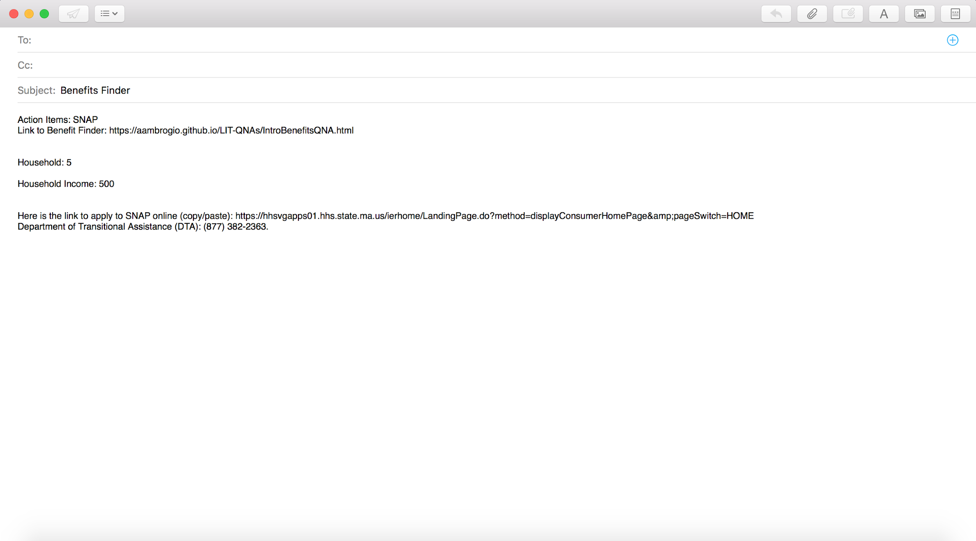

Slide 11
Future Goals
Share
Sustain
Improve
Expand

Slide 12
MA Public Benefits Finder
Try it out yourself!
Type the following URL into your browser:
https://bit.ly/2E4UELK

